Slide 1
Macro Expression Detection
Resıdual Maskıng network – Fer2013 dataset

Slide 2
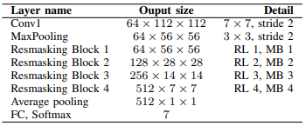
Residual Masking Network
Backbone: ResNet34 with Residual Masking Blocks - (ImageNet pretrained backbone)
Optimizers: SGD with Momentum
Regularizations: BatchNorm, Weight Decay
Data Augmentations: Left-Right Flipping, Rotating, Test-Time Augmentation - (During evaluation)
Loss Function: Cross-Entropy Loss
Input Size: 224x224 RGB
LR Scheduling: Reducing 10 times when validation performance plateaus
Main Flow: (RL=Residual Layer,
MB=Masking Block)

Slide 3
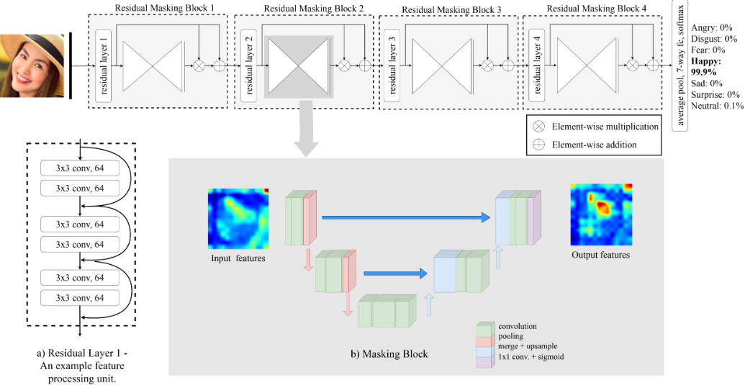
Residual Masking Blocks

Slide 4
Hyperparameter Choices
Hyperparameter | Value
Learning Rate | 0.0001
Momentum | 0.9
Weight Decay | 0.001
Batch Size | 48
Max Epoch Number | 50
Plateau Patience | 2
Max Plateau Count | 8
Model also resizes inputs into 224x224 RGB to match backbones that are pretrained with ImageNet

Slide 5
FER2013 Dataset - https://www.kaggle.com/datasets/msambare/fer2013
Total images: 35.887 samples
Image size: 48x48 pixels
Color format: Grayscale (1 channel)
Labels: 7 emotional classes
Dataset Split:
Train | Validation | Test
%80 | %10 | %10
28.709 | 3.589 | 3.589

Slide 6
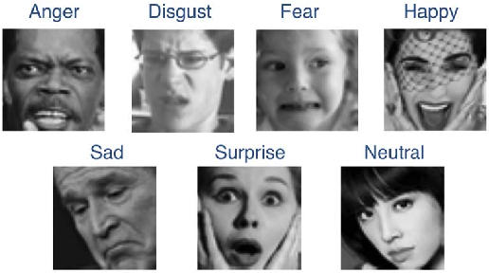
Emotional Classes
Class | Sample
Angry | 4.977
Disgust | 546
Fear | 5.153
Happy | 8.973
Sad | 6.018
Surprised | 4.003
Neutral | 6.217
Notes:
sadasdaj

Slide 7
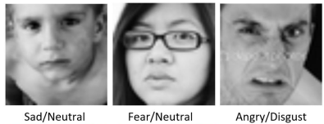
Issues of the Dataset
Low Resolution
Grayscaled samples
Ambiguous expressions
Imbalanced sample distribution
Imbalanced sample distribution, causes model to be dominated by majority classes, especially in training. This, also influences the result and doesn’t correctly reflect the performance of minority classes.

Slide 8
Weighted Cross-Entropy Loss
The difference of Weighted CE loss is it assigns weights to each class to adjust their impact on training.
Class | Size | Weight
Angry | 4.977 | 1.0266
Disgust | 546 | 9.4066
Fear | 5.153 | 1.0010
Happy | 8.973 | 0.5684
Sad | 6.018 | 0.8491
Surprised | 4.003 | 1.2934
Neutral | 6.217 | 0.8260
Weights, which are derived from inverse class frequency, allows model to learn each class fairly and balanced.
Trade-off
Due to the assigned weights, minor classes are expected to perform better. On the other hand, domination of majority classes would be reduced. Therefore, slight decreases in majority classes are also expected.
This trade-off might even have effects on overall accuracy.
Motivation
By making this change, we accepted the possible decrease in accuracy for the sake of achieving a more balanced model that performs fairly in each class and more adapted to real world situations.

Slide 9
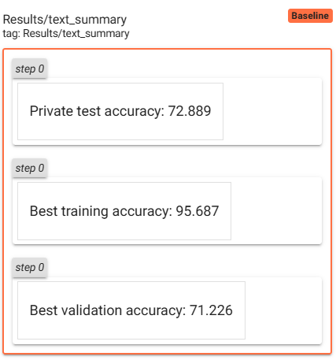
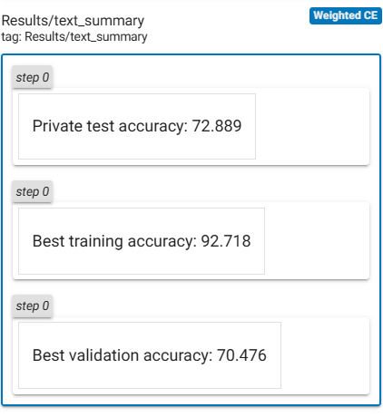
Overall Results

Slide 10
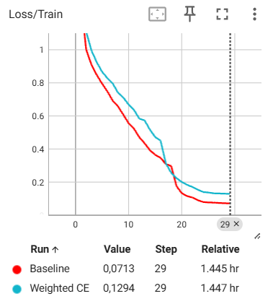
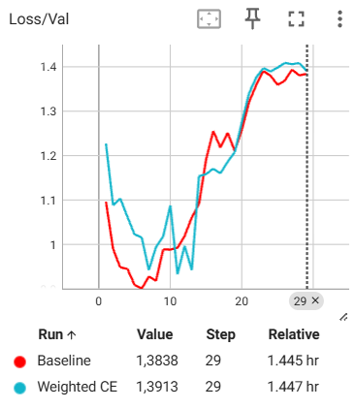
Loss Curves

Slide 11
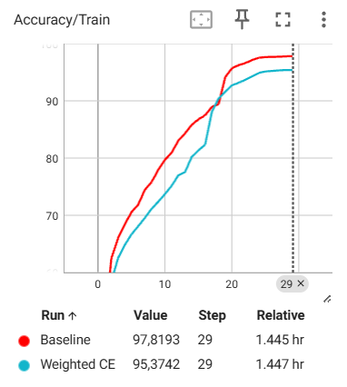
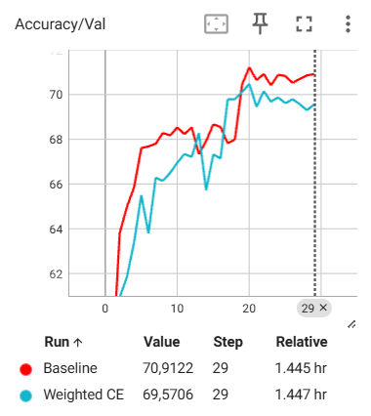
Accuracy Curves

Slide 12
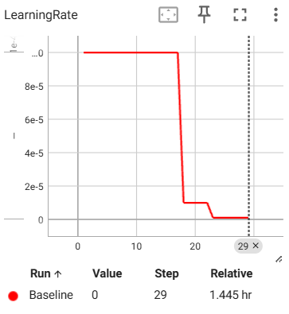
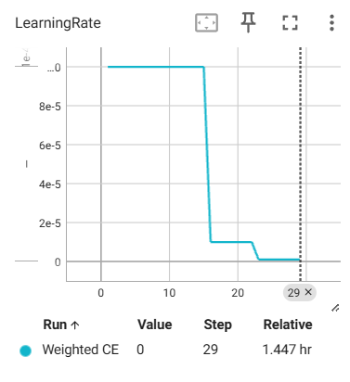
LR Curves

Slide 13
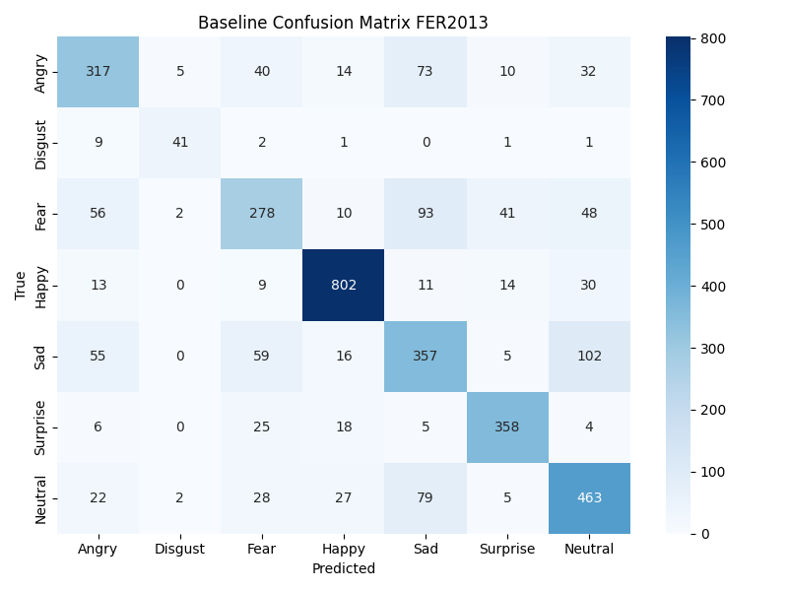
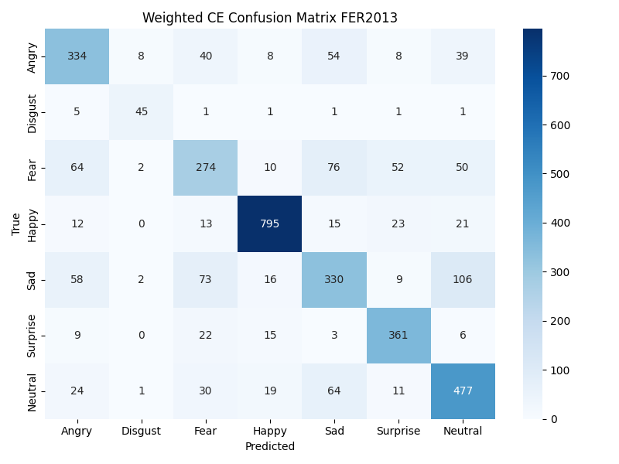
Confusion Matrices Of Each Model (Num of Samples)

Slide 14
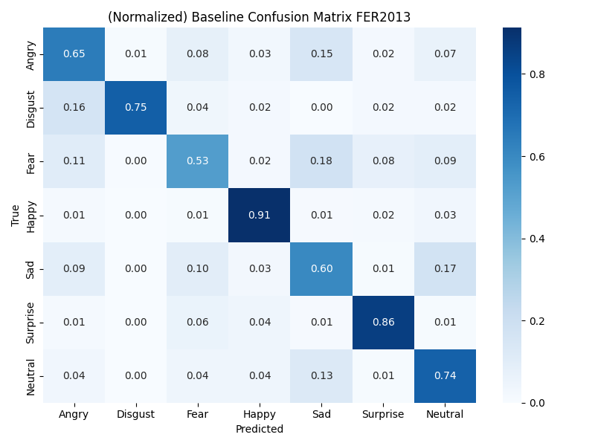

Confusion Matrices of Each Model (Percentages)

Slide 15
Thank you for listening

